Slide 1
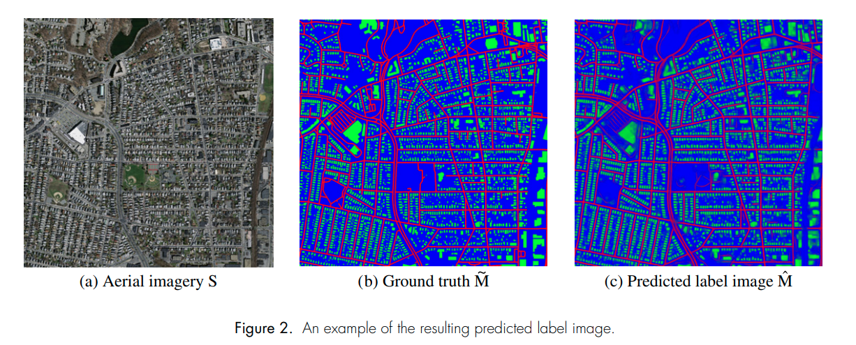
CNN
Example:

Slide 2
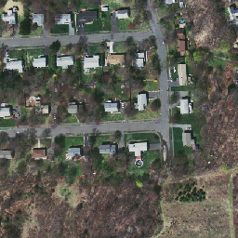

CNN
My result (even tested with the validation data)
?
Too slow: 3 hours for a 1000*1000 image

Slide 3
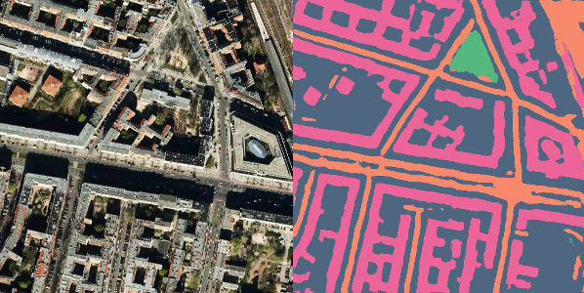
RoboSat - OpenStreetMap
feature extraction from satellite imagery:
buildings, parking lots, roads, or cars

Slide 4
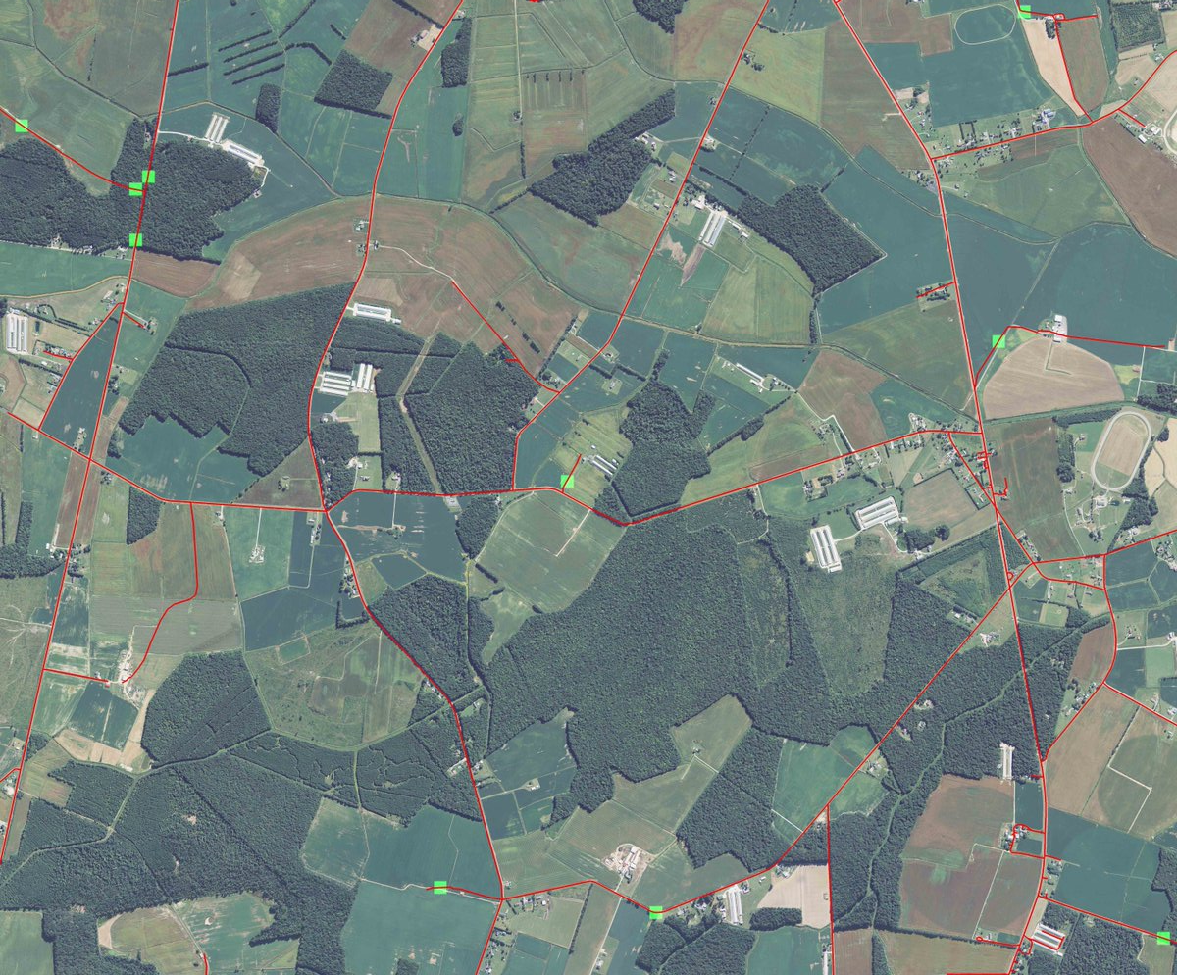
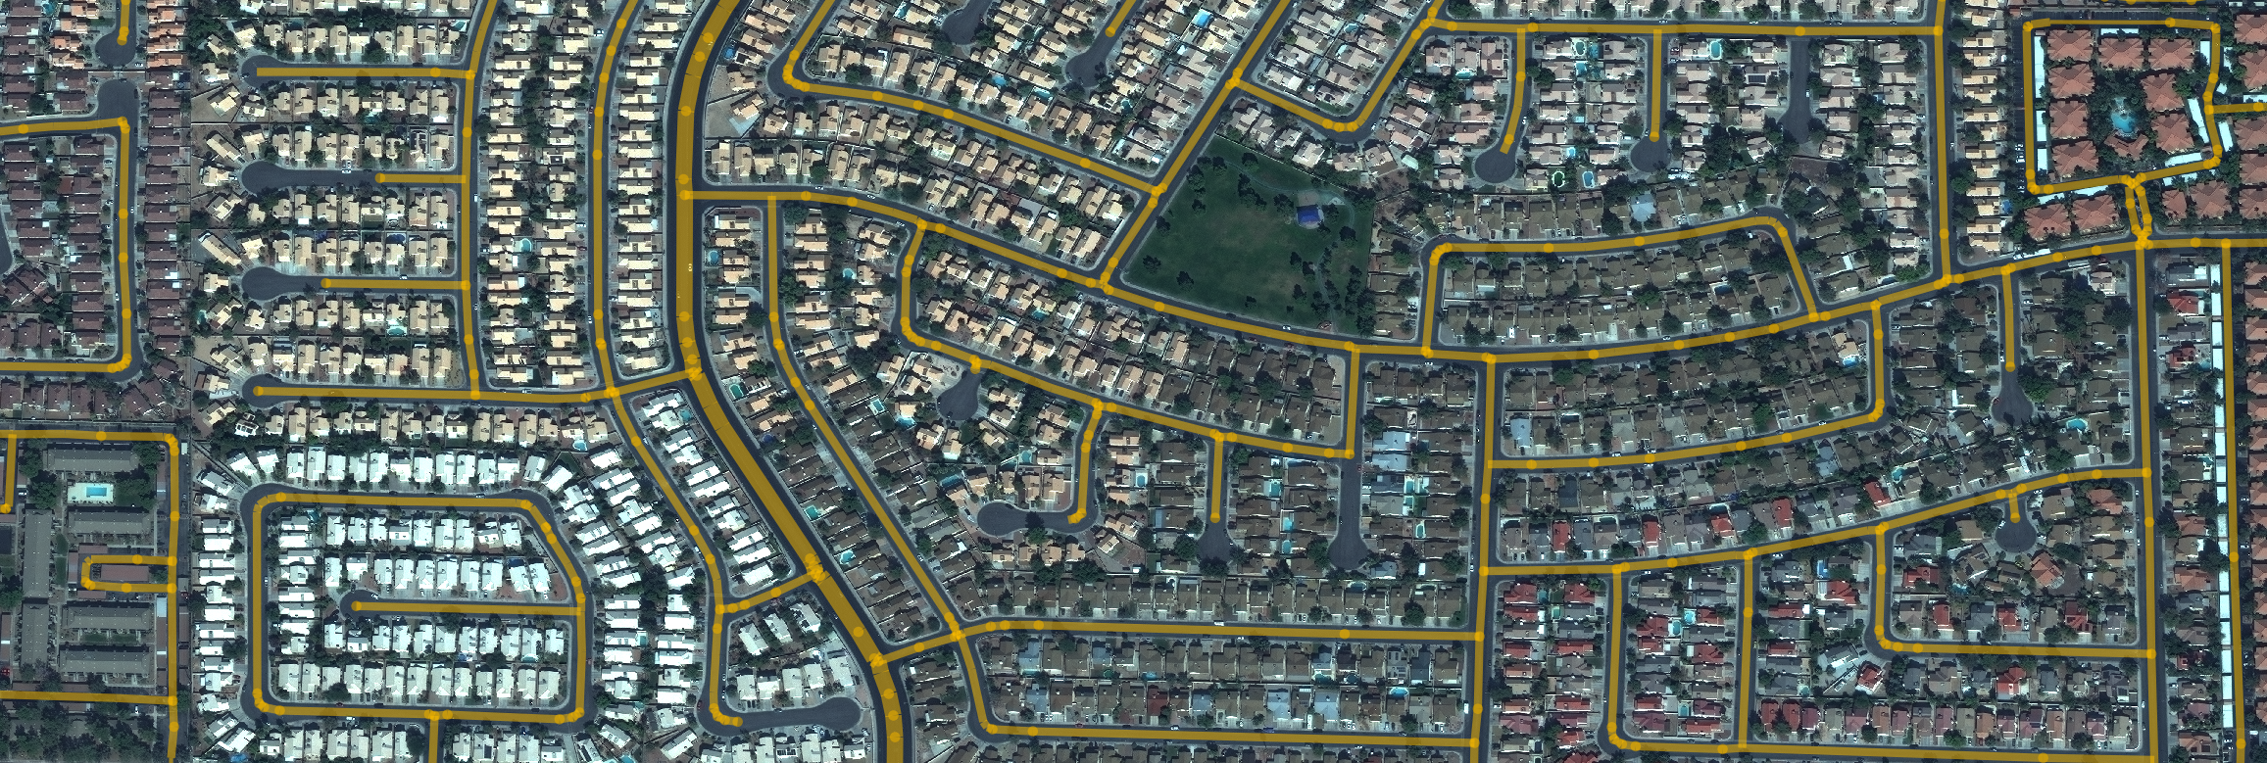
CNN trained with OSM data
DeepOSM
City-scale Road Extraction

